Slide 1
CSC 101 – Introduction to Computing
Lecture 13 (Morley Ch 9)

Slide 2
Outline
Basic Security Concepts
Threats to User
Threats to Hardware
Threats to Data
Counter Measures

Slide 3
Basic Security
There are a number of security concerns related to computers that users should be concerned about, including:
– Having a computer or other device stolen
– Losing important documents
– Losing a smartphone containing contacts and other important data
– Buying pirated or counterfeited products

Slide 4
Basic Security Terminology
Vulnerability
Weakness in the system that can be exploited to do harm e.g. unlocked car.
Threat
Set of circumstances that has the potential to cause loss or harm
Anything that can cause harm e.g. thief, a virus, earthquake.
Attack
When an entity exploits a vulnerability on system e.g. car stolen, Denial of Service.
Countermeasure
Steps taken to ward off threat e.g. car lock, firewall,.
Notes:
Threat: Set of circumstances that has the potential to cause loss or harm

Slide 5
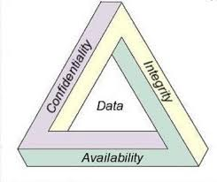
Basic Security Requirements
“CIA” triad of security requirements:
Confidentiality
Only authorized person can read data
Integrity
Data is not modified
Availability
Resources are available when required
Other core security requirements:
Authentication
Proof of identity
Authorization
Related to access control
Non-repudiation
Assurance that a transferred message has been sent and received by the parties claiming to have sent and received the message respectively.
Notes:
authentication is the process of verifying who someone is, whereas authorization is the process of verifying what specific applications, files, and data a user has access to.
Reject denial

Slide 6
Information security
Information security is the process of protecting information from unauthorized access, use, disclosure, destruction, modification, or disruption.
OR
Information security is protecting the confidentiality, integrity and availability of information

Slide 7
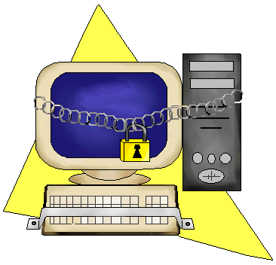
Why Security?

Slide 8
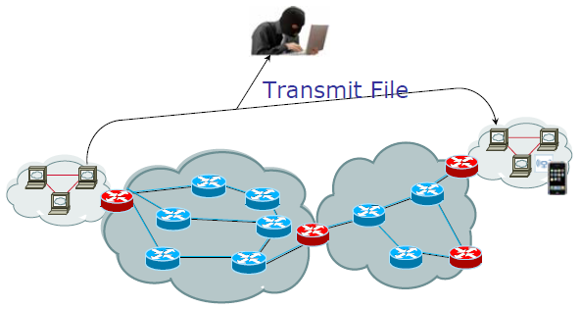
Example 1

Slide 9
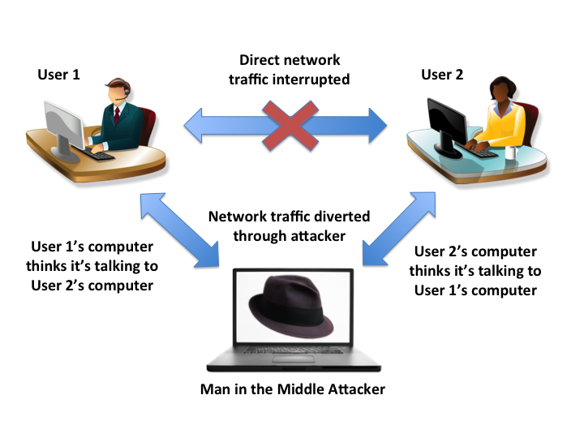
Example 2

Slide 10
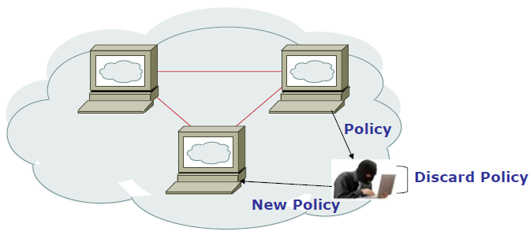
Example 3

Slide 11
Types of Threats
Threat to User
Threat to Hardware
Threat to Data

Slide 12
Threat to User
Identity Theft
Loss of Privacy
Online Spying Tools
Online Theft
Online Fraud, & Other Dot Cons
Notes:
Teaching tip
The move Hackers includes scenes demonstrating most of these crimes in action.

Slide 13
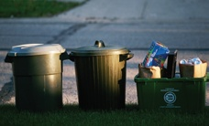
Identity Theft
Impersonation by private information to obtain documents and credit in your name
Thief can ‘become’ the victim
Reported incidents rising
Methods of stealing information
Shoulder surfing
Snagging
Dumpster diving
Social engineering
High-tech methods
Notes:
Teaching tip
The move Hackers includes scenes demonstrating most of these crimes in action.

Slide 14
Loss of privacy
Personal information is stored electronically
Purchases are stored in a database
Data is sold to other companies
Public records on the Internet
Internet use is monitored and logged
monitoring activity can be carried out on your computer or a connected server
Data about when you visited, what you looked at, and how long you stayed is used by most commercial Web sites “online profiling”
None of these techniques are illegal

Slide 15
Online Spying
Software downloaded to a computer
tracks a computer user's activities and report them to someone else
Another common term for spyware is adware,
Cookies
a small text file that a Web server asks your browser to place on your computer
Cookie contains information like your IP address, name/email, and information about your visit to the Web site.
Originally improved a site’s function but now tracks history
Web Bug
Small GIF format image file embedded in web page or HTML format e-mail
Can record webpages, passwords, and personal info.
Spam
is Internet “ junk mail.”
Almost all spam is commercial advertising

Slide 16
Online Theft, Online Fraud, and Other Dot Cons
Dot Con
A fraud or scam carried out through the Internet
The Internet Crime Complaint Center received and processed more than 24,000 complaints per month in 2012
Data or Information Theft
Theft of data or information located on or being sent from a computer
Can occur in several ways
Stealing an actual computer or mobile device
A hacker gaining unauthorized access
Identity Theft
Using someone else’s identity to purchase goods or services, obtain new credit cards or bank loans, or illegally masquerade as that individual
Information obtained via documents, stolen information, spyware, etc.

Slide 17
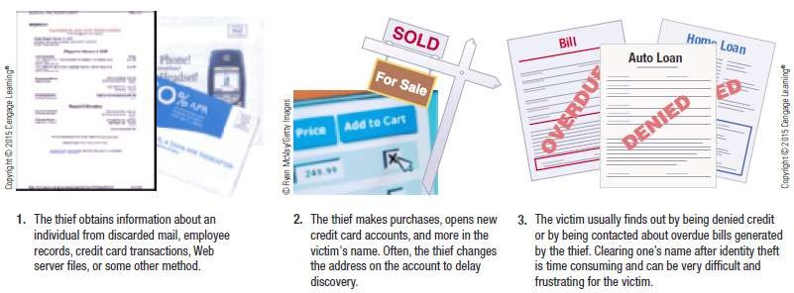

Online Theft, Online Fraud, and Other Dot Cons

Slide 18
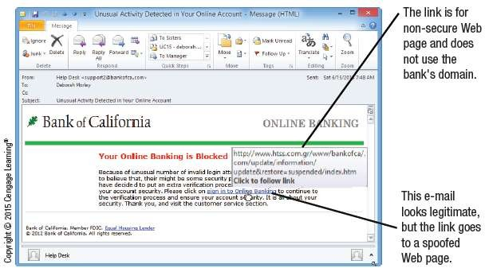
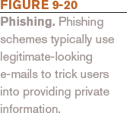
Online Theft, Online Fraud, and Other Dot Cons

Slide 19
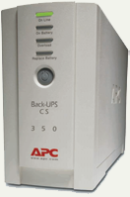
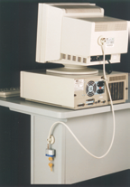
Threats to Hardware
Power-related threats
Power fluctuations
Power loss
Can result in loss of data
Countermeasures
Uninterruptible power supplies
Generators
Theft and wreckage
Thieves steal the entire computer
Accidental or intentional damage
Countermeasures
Keep the PC in a secure area
Lock the computer to a desk
Notes:
Teaching tip
Visit www.apc.com for information regarding UPS solutions.
Teaching tip
Larger installations use generators to protect networks. Hospitals, grocery stores and insurance companies may all use generators. Quite often the power solution is a combination of battery and generator. The batteries run long enough for the generators to start and stabilize. Then the batteries stop and the generators provide power to the facility.

Slide 20
Threats to Hardware
Unauthorized Access
Gaining access to a computer, network, file, or other resource without permission
Unauthorized Use
Using a computer resource for unapproved activities
Hacking
Using a computer to break into another computer system.
A serious threat for individuals, businesses, and the country (national security), i.e., cyberterrorism
Wi-Fi Piggybacking
Wi-Fi piggybacking is the practice of using someone else's Wi-Fi network without their permission, often to access the internet for free.
Notes:
Teaching tip
Visit www.apc.com for information regarding UPS solutions.
Teaching tip
Larger installations use generators to protect networks. Hospitals, grocery stores and insurance companies may all use generators. Quite often the power solution is a combination of battery and generator. The batteries run long enough for the generators to start and stabilize. Then the batteries stop and the generators provide power to the facility.

Slide 21
Protecting Against Unauthorized Access and Unauthorized Use
Access Control Systems
Used to control access to facilities, computer networks, company databases, and Web site accounts
Identification Systems
Verify that the person trying to access the facility or system is an authorized user
Authentication Systems
Determine if the person is who he or she claims to be

Slide 22
Protecting Against Unauthorized Access and Unauthorized Use
Cognitive Authentication Systems
Use information the individual knows or can easily remember (birthplace, pet names, etc.)
Used in many password recovery systems
Two-Factor Authentication
Using two different methods to authenticate users
Typically possessed knowledge (password) with either
Biometric Feature – something you are
Possessed Object – something you have
Hard token – physical object used
Soft token – supplies a one-time password (OTP)

Slide 23
Protecting Against Unauthorized Access and Unauthorized Use
Firewalls
A collection of hardware and/or software intended to protect a computer or computer network from unauthorized access
Intrusion Prevention System (IPS) Software
Monitors traffic to try and detect possible attacks
If an attack is discovered, IPS software can immediately block it
Encryption
Method of scrambling contents of e-mail or files to make
them unreadable if intercepted
Secure Web pages use encryption

Slide 24

Threats to Hardware
Natural disasters
Disasters differ by location
Typically result in total loss
Disaster planning
Be aware that a disaster could strike
Anticipate it when conditions are right
Plan for recovery
List potential disasters
Plan for all eventualities
Practice all plans
Notes:
Discussion point
In 2004 Hurricane Ivan caused massive damage to Florida and several other states. Network administrations in Florida are used to planning for hurricanes. However, computers in Southeastern Pennsylvania suffered massive loss of data due to Ivan. How culpable are the administrators in PA who did not plan for Ivan?

Slide 25
Threats to Data
Data, Program, or Web Site Alteration
Sabotage occurs when a hacker breaches a computer system in order to delete/change data or modify programs
Student changing grades
Employee performing resentful acts, such as deleting or changing corporate data
Data on Web sites can also be altered
Hacking into and changing social networking account contents (Facebook pages, Twitter tweets, etc.)
Altering legitimate site to perform malware attacks

Slide 26
Threats to Data: Malware
Mobile Malware
Can infect smartphones, media tablets, printers, etc.
Smartphones with Bluetooth are particularly vulnerable to
attack
Mobile threats are expected to continue to increase
Denial of Service (DoS) Attacks
Act of sabotage that attempts to flood a network server or Web server with so much activity that it is unable to function
Distributed DoS Attacks target popular Web sites and use multiple computers

Slide 27
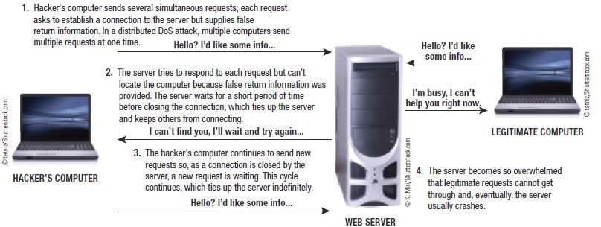

Threats to Data: Malware

Slide 28
Threats to Data: Virus
Computer Viruses
A software program installed without the user’s knowledge and designed to alter the way a computer operates or to cause harm to the computer system
Often embedded in downloaded programs and e-mail messages (games, videos, music files)
Computer Worm
Malicious program designed to spread rapidly by sending copies of itself to other computers via a network
Typically sent as an e-mail attachment

Slide 29
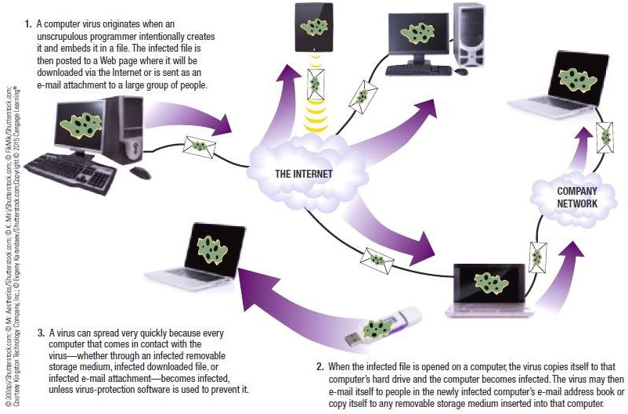
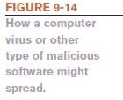
Threats to Data: Virus

Slide 30
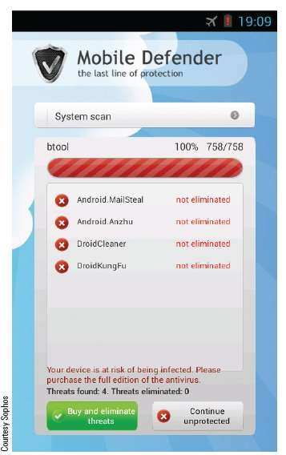
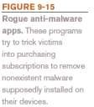
Threats to Data: Malicious Program
Trojan Horse
Malicious program that masquerades as something else
Usually appears to be a game or utility program
Cannot replicate themselves; must be
downloaded and installed
Rogue antivirus programs (scareware) are common today
Ransomware

Slide 31
CyberCrime
Computer Crime (cybercrime)
Any illegal act involving a computer, including:
Theft of financial assets
Manipulating data for personal advantage
Act of sabotage (releasing a computer virus, shutting down a Web server)
Phishing and Internet scams
All computer users should be aware of security concerns and the precautions that can be taken
Cyber Terrorism
Cyber Bullying
Cyber Stalking

Slide 32
CSC 101 – Introduction to Computing
Lecture 14 (Morley Ch 10)

Slide 33
Outline
Information Systems & System Development:
Need for System Development Enterprise Architecture
Users of Information Systems
Types of Information Systems
System Development Life Cycle (SDLC)

Slide 34
What Is an Information System?
System
Collection of elements and procedures that interact to accomplish a goal
Football game, transit systems, etc.
Information System
A system used to generate the information needed to support the users in an organization
Digital Ecosystem
The collection of people, products, services, and business processes related to a digital element
Apple digital ecosystem = Apple hardware, software, and online services

Slide 35
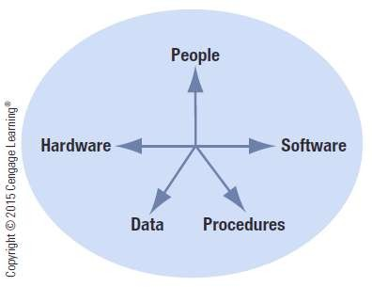

What Is an Information System?

Slide 36
What Is an Information System?
The Need for System Development
Systems development
Process of designing and implementing a new or modified system
System development may be required because of:
New laws (Sarbanes-Oxley Act, HIPAA etc.)
Changes to the legal requirements for retaining business data (e-disclosure, etc.)
Introduction of new technology

Slide 37
What Is an Information System?
Enterprise Architecture
Provides a detailed picture of an organization, its function, its systems, and the relationship among them
Allows managers to organize and maximize the use of IT resources and make better decisions
Not easy to develop and requires time and effort, but once in place, it is an invaluable decision support tool

Slide 38
What Is an Information System?
Business Intelligence (BI)
The process of gathering, storing, accessing, and analyzing data in order to make better business decisions
Business analytics (BA)
The process of analyzing data to evaluate a company’s operations
Data Warehouse
Comprehensive collection of data about a company and its customers
Data mart is smaller and typically stores data related to a particular subject or department

Slide 39
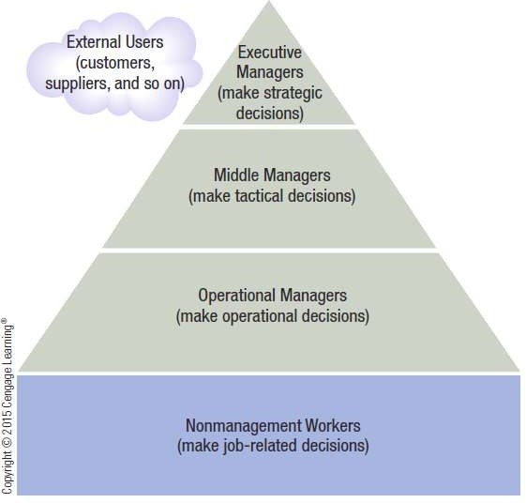
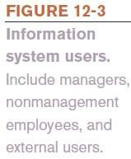
Users of Information Systems
User Groups
Executive managers
Middle managers
Operational managers
Nonmanagement workers
External users

Slide 40
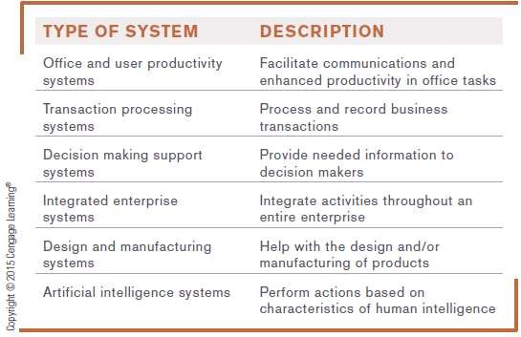

Types of Information Systems
Notes:
Integrated: Inventory and Product Management Systems

Slide 41
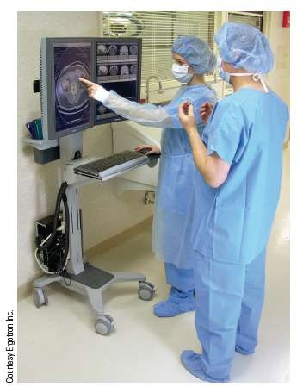
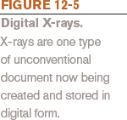
Types of Information Systems
1. Office and User Productivity Support Systems
Office System
Document Processing Systems
Document Management Systems (DMSs)
Content Management Systems (CMSs)
Communication Systems

Slide 42
Types of Information Systems
2. Transaction Processing Systems (TPSs)
Processes and records data created by an organization’s business transactions
Usually processed in real time
Order Entry Systems
Payroll Systems
Accounting Systems

Slide 43
Types of Information Systems
3. Decision Making Support Systems
Help individuals make decisions
Management Information Systems (MISs)
Provides decision makers with regular, routine, and timely information that is used to make decisions
Decision Support Systems (DSSs)
Provides people with the tools and capabilities to organize and analyze their decision making information
Typically are interactive and provide information on demand
Geographic Information Systems (GISs)
Combines geographical information with other types of data to provide a better understanding of relationships among the data

Slide 44
Types of Information Systems
4. Integrated Enterprise System
Electronic Data Interchange (EDI)
Transfers data between different companies using the Internet or another network
Enterprise Resource Planning (ERP)
Large integrated system that ties together all of a business’s activities
Inventory and Product Management Systems
Tracks and manages inventory
Supply Chain Management (SCM)
Just-in-time (JIT)
Resources are limited to the right amount at the right time to fill orders
Warehouse Management Systems (WMS)

Slide 45
Types of Information Systems
5. Design and Manufacturing Systems
Used to improve productivity at the product design stage and manufacturing stage
Computer-aided design (CAD)
Use of computer technology to automate design functions
Computer-aided manufacturing (CAM)
Use of computer technology to automate manufacturing functions

Slide 46


Types of Information Systems
6. Artificial Intelligence Systems
A system in which a computer performs actions that are characteristic of human intelligence
Initial advances in AI made through chess-playing programs
Watson supports human interactions

Slide 47
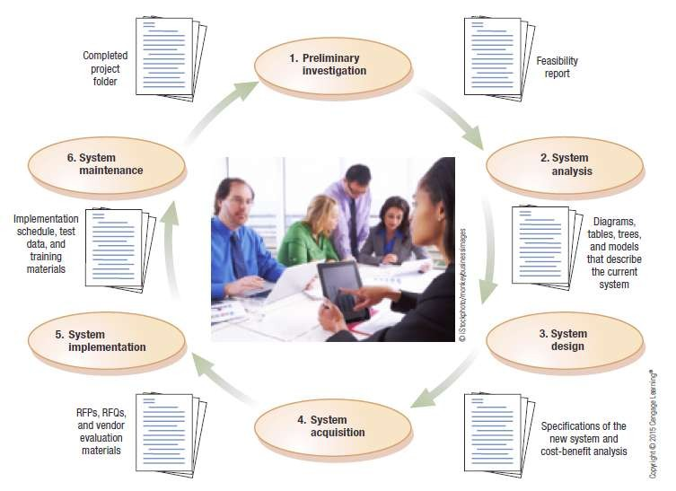
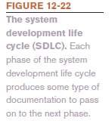
The System Development Life Cycle (SDLC)
SDLC : The development of a system from the time it is first studied until the time it is updated or replaced

Slide 48
The System Development Life Cycle (SDLC)
Preliminary Investigation
A feasibility study is performed to assess whether or not a full-scale project should be undertaken
Documentation: Feasibility Report
Contains findings on status of existing system and benefits/feasibility of changing to a new system
Includes system analysts’ recommendations regarding whether or not the project should move on to the next stage in the SDLC

Slide 49
The System Development Life Cycle (SDLC)
System Analysis
Examines the problem area to determine what should be done
Data Collection
Gathering information about the system (organizational chart, observation, interviewing users, etc.)
Data Analysis
Analyzing information to determine the effectiveness and efficiency of current system and/or requirements for new or modified systems

Slide 50
The System Development Life Cycle (SDLC)
Entity-Relationship Diagrams (ERDs) and Data Flow Diagrams (DFDs)
Used to model the entities in a system and the flow of data within the system
Decision Tables and Decision Trees
Useful for identifying procedures and summarizing the decision making process of one step of a system

Slide 51
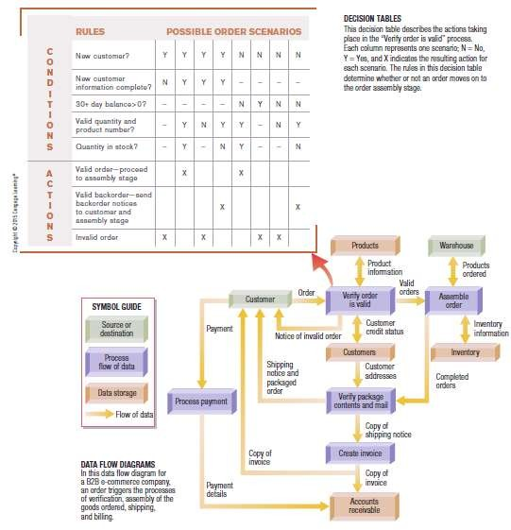
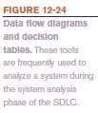
The System Development Life Cycle (SDLC)

Slide 52
The System Development Life Cycle (SDLC)
Business Process Modeling Notation (BPMN)
A graphical, standardized notation used to model the business processes used within systems
Designed to be understood by all individuals involved in the system
Expresses processes graphically using diagrams similar to flowcharts

Slide 53
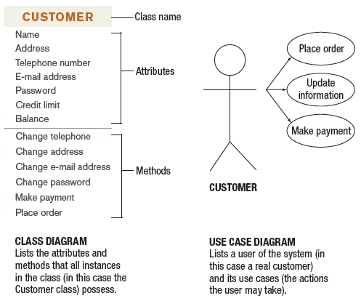
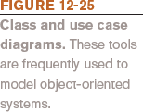
The System Development Life Cycle (SDLC)
Class Diagrams and Use Case Diagrams
– Used to illustrate systems that are based on the concept of objects

Slide 54
The System Development Life Cycle (SDLC)
Documentation: Diagrams, Tables, Trees, and Models
Consists of any instruments used for data gathering and the resulting diagrams, trees, models, and other tools used to summarize and analyze the data
Questionnaires
Interview questions
Diagrams, models, etc.

Slide 55
The System Development Life Cycle (SDLC)
System Design
Specifies what the new system will look like and how it will work
Developing the Design and Specifications for the New System
Model of new system is developed
Diagrams can include:
Data dictionary: describes all data in a system
Data flow and/or class diagrams of the new system
User interface (UI) designs

Slide 56
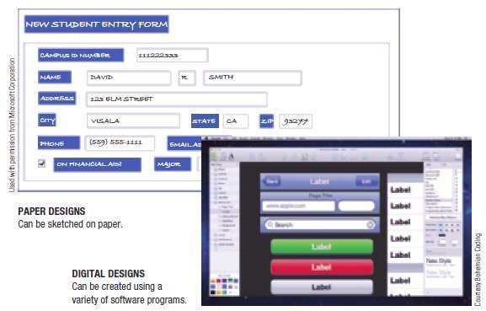

The System Development Life Cycle (SDLC)

Slide 57
The System Development Life Cycle (SDLC)
Cost-Benefit Analysis
Considers both tangible and intangible benefits to determine if the benefits of the new system outweigh the cost
Documentation: System Design/Specifications
Developed during the system design phase
Consists of all documentation necessary to illustrate the new system

Slide 58
The System Development Life Cycle (SDLC)
System Acquisition
System analysts determines where to obtain the necessary hardware, software, and other system components
The Make-or-Buy Decision
Determining if the software needed will be purchased from a vendor or developed in-house
– If developed in-house, software to be developed moves into the program development process

Slide 59
The System Development Life Cycle (SDLC)
System Implementation
The new system is installed, tested, and made operational
Data migration
System must be thoroughly tested
Test data should be realistic and include incorrect data

Slide 60
The System Development Life Cycle (SDLC)
System Conversion
Once testing phase is completed, system is installed
Direct conversion
» Old system deactivated and new system is immediately implemented
Parallel conversion
» Both systems are operated simultaneously until it is determined that the new system works properly
Phased conversion
» System is implemented by module

Slide 61
The System Development Life Cycle (SDLC)
– Pilot conversion
New system used at just one location within the organization
User Training
All training manuals should be developed and given to users
Training takes place on the actual system
Can occur one-on-one or in groups
Documentation: Implementation Schedule, Test Data and Results, and Training Materials
Implementation schedule, test data, test results, training materials should be saved for future reference

Slide 62
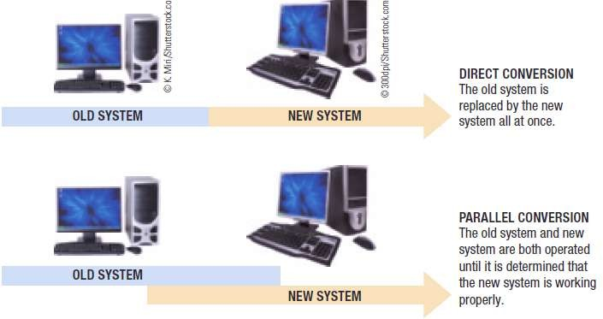

The System Development Life Cycle (SDLC)

Slide 63
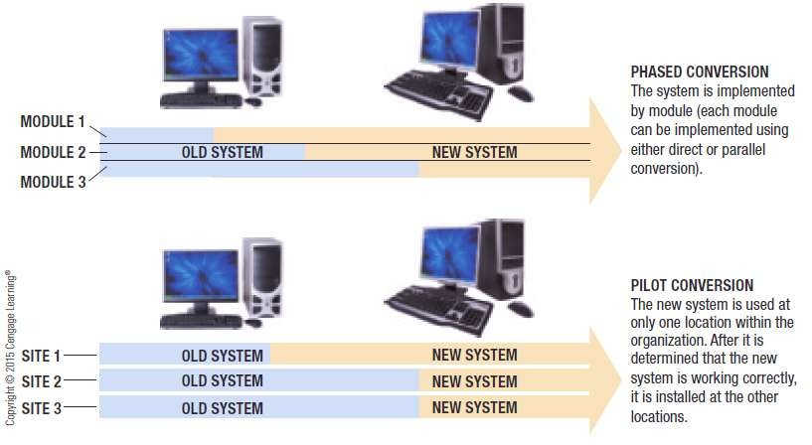
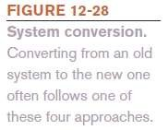
The System Development Life Cycle (SDLC)

Slide 64
The System Development Life Cycle (SDLC)
System Maintenance
Maintenance is an ongoing process
Minor adjustments are made to the finished system to
keep it operational until the end of the system’s life or until the time that the system needs to be redesigned
Post-Implementation Review
Identifies any glitches in the new system that need to be fixed
When a major change is needed, the project goes through the SDLC again

Slide 65
The System Development Life Cycle (SDLC)
Documentation: Completed Project Folder
Results of the post-implementation review are added to the accumulated documentation
Information can be useful to auditors who may check to see that proper procedures were followed

Slide 66
Approaches to System Development
The Traditional Approach
SDLC phases are carried out in a preset order
Preliminary investigation
System analysis
System design
System acquisition
System implementation
System maintenance

Slide 67
The System Development Life Cycle (SDLC)
Referred to as the waterfall model
Each phase begins only when previous one is completed
Time-consuming
The Iterative Approach
System is developed incrementally
Steps are repeated until the system is finalized
Prototyping
Small model, or prototype, of the system is built before the full-scale development effort is undertaken

Slide 68
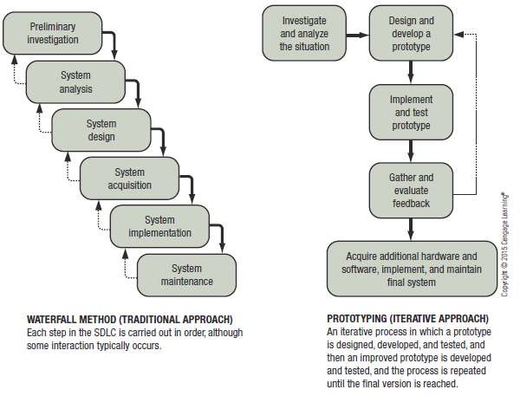

Approaches to System Development

Slide 69
Approaches to System Development
The End-User Development Approach
User is primarily responsible for the development of the system
Most feasible when system being developed is small and inexpensive
Measures must be taken to ensure that the system is compatible with existing systems and no new problems are introduced

Slide 70
Summary
Information Systems & System Development:
Need for System Development Enterprise Architecture
Users of Information Systems
Types of Information Systems
System Development Life Cycle (SDLC)

